Slide 1


Slide 2
THE IDEA

Slide 3
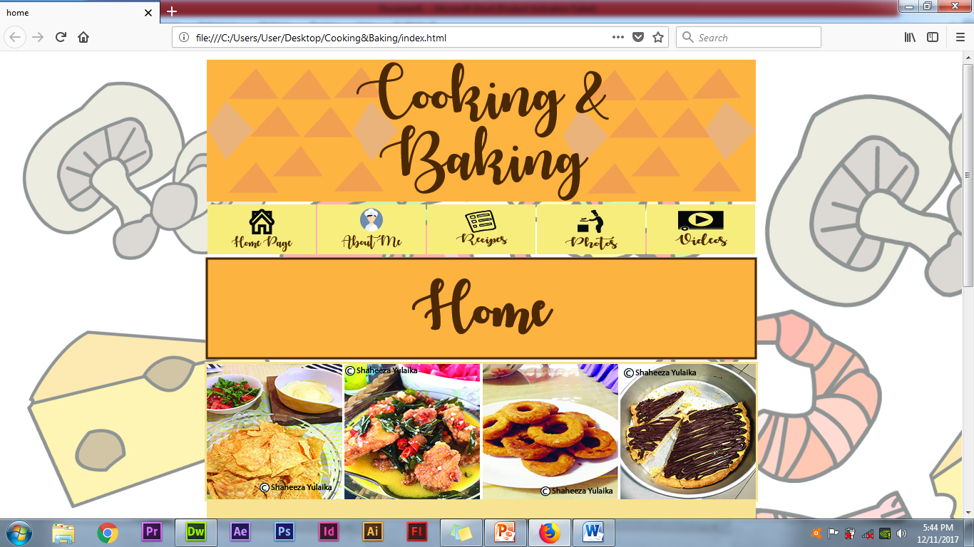
SIZE & THEME
Theme:
Cooking & Baking
Orange, peach & chocolate
Stage:
1920x1080

Slide 4


Slide 5
EMPHASIS
Things that I like; Cooking & Baking
BALANCE
Balance between graphic
Asymetrical
Location of each button are in the same location

Slide 6
TYPOGRAPHY
Autumn in November & Tahoma, Geneva (sans-serif)
COLOUR
Chocolate font
Orange & Peach background

Slide 7
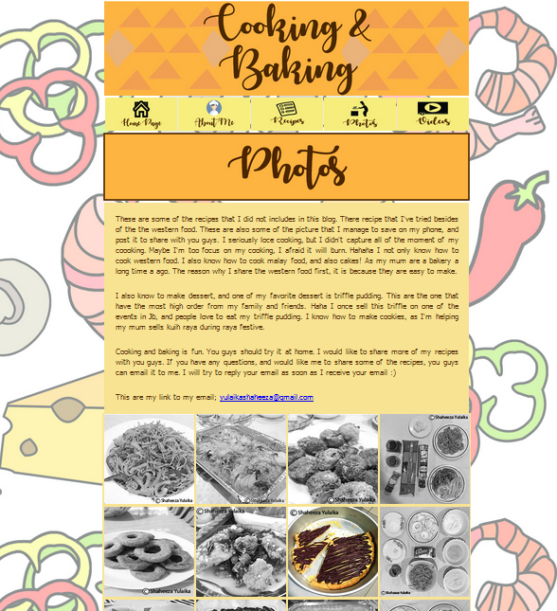
CONTRAST
The background that the designer use is the png illustration of ingredients as it is to contrast with the box of the background for text, banner, buttons, swf and copyright
Text and title, the designer contrasts it with size, typefaces and colour.
The designers have created a well contrast of every subjects with rollover images of the buttons

Slide 8
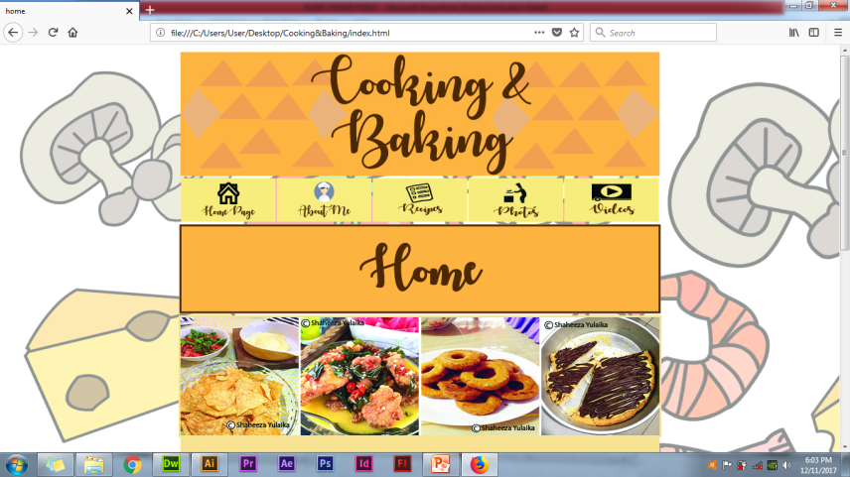
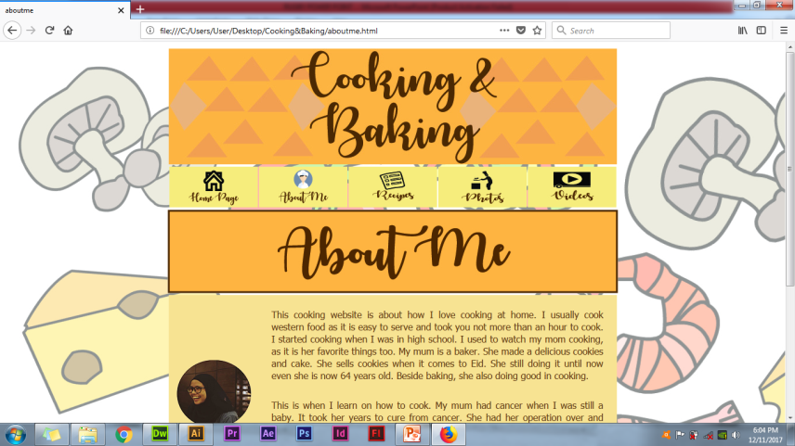
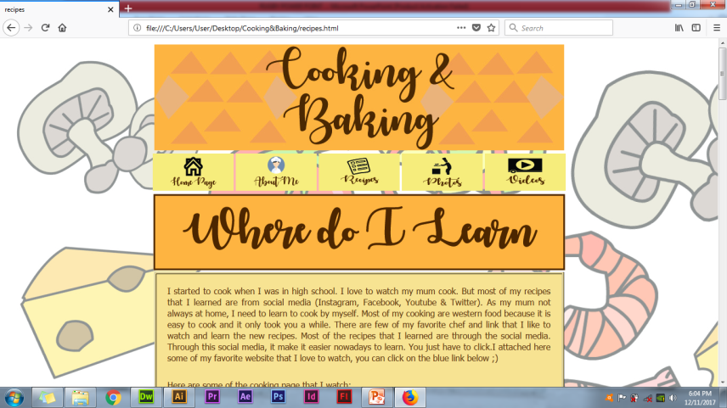
FLOW
1
4
2
5
3
6

Slide 9
IMAGES & ILLUSTRATION

Slide 10


Slide 11


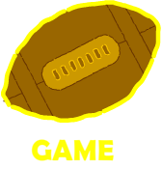
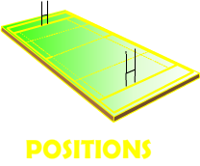



BUTTON

Slide 12
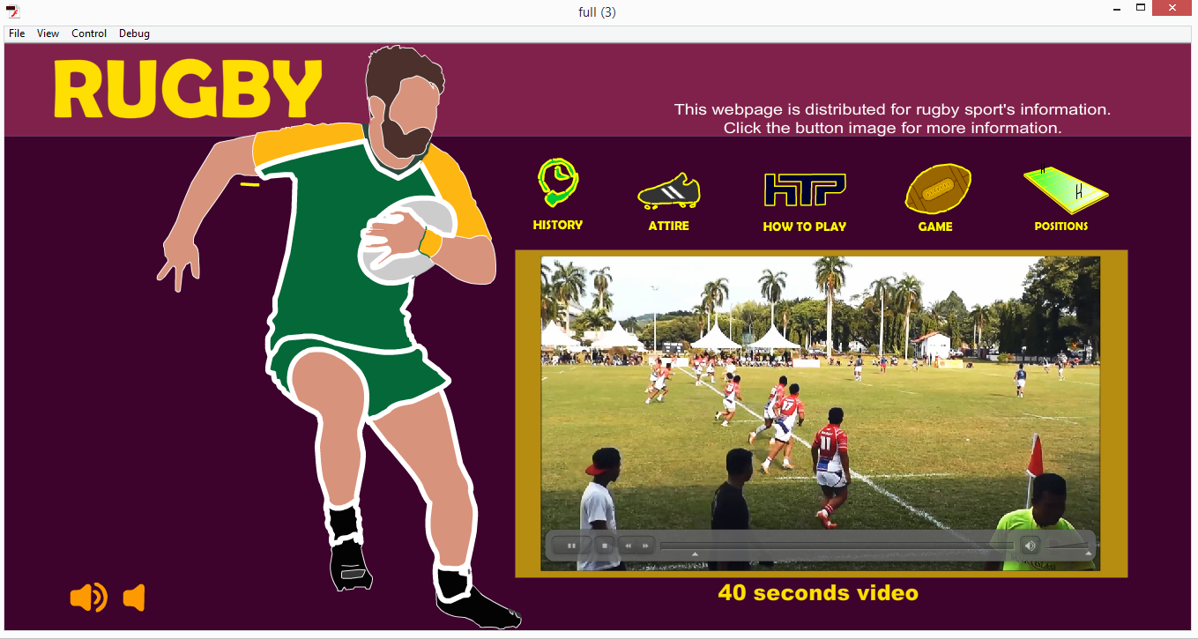
ANIMATION
Scene 1

Slide 13
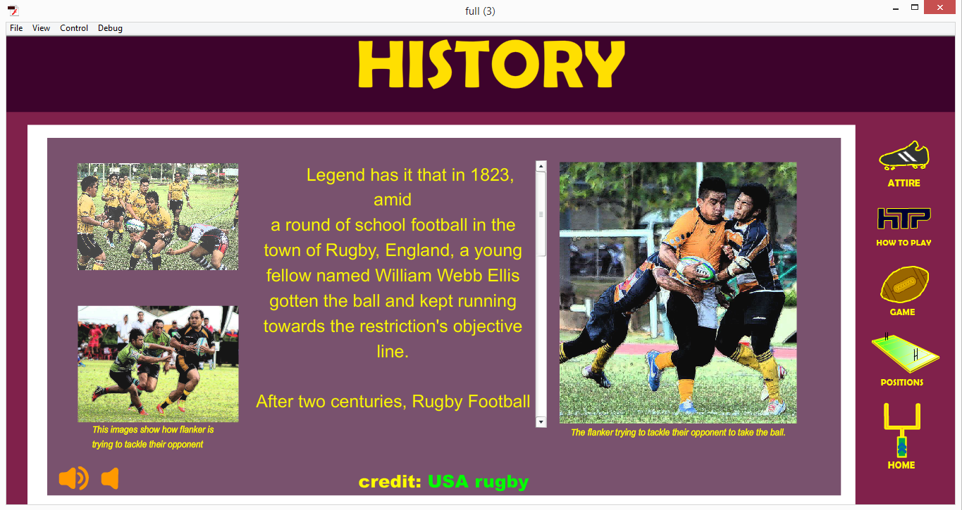
Scene 2

Slide 14
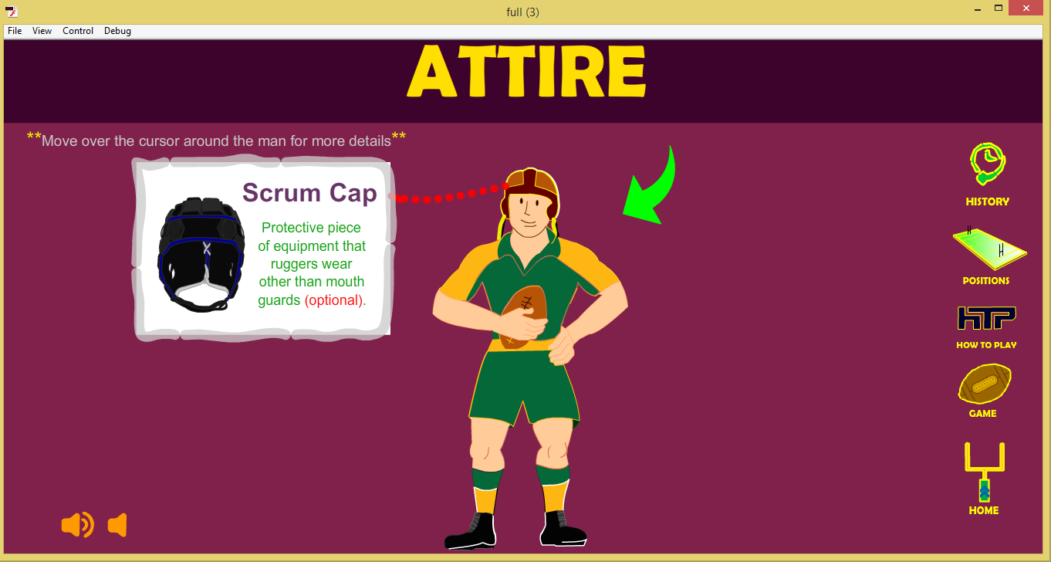
Scene 3

Slide 15
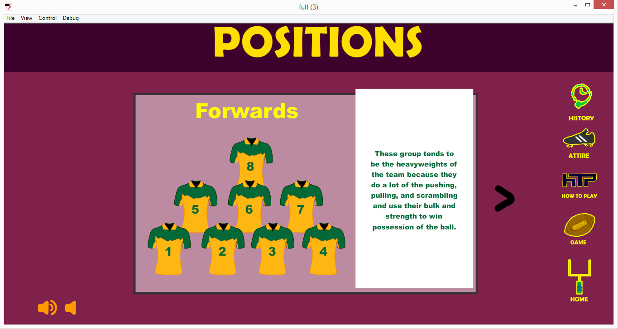
Scene 4

Slide 16
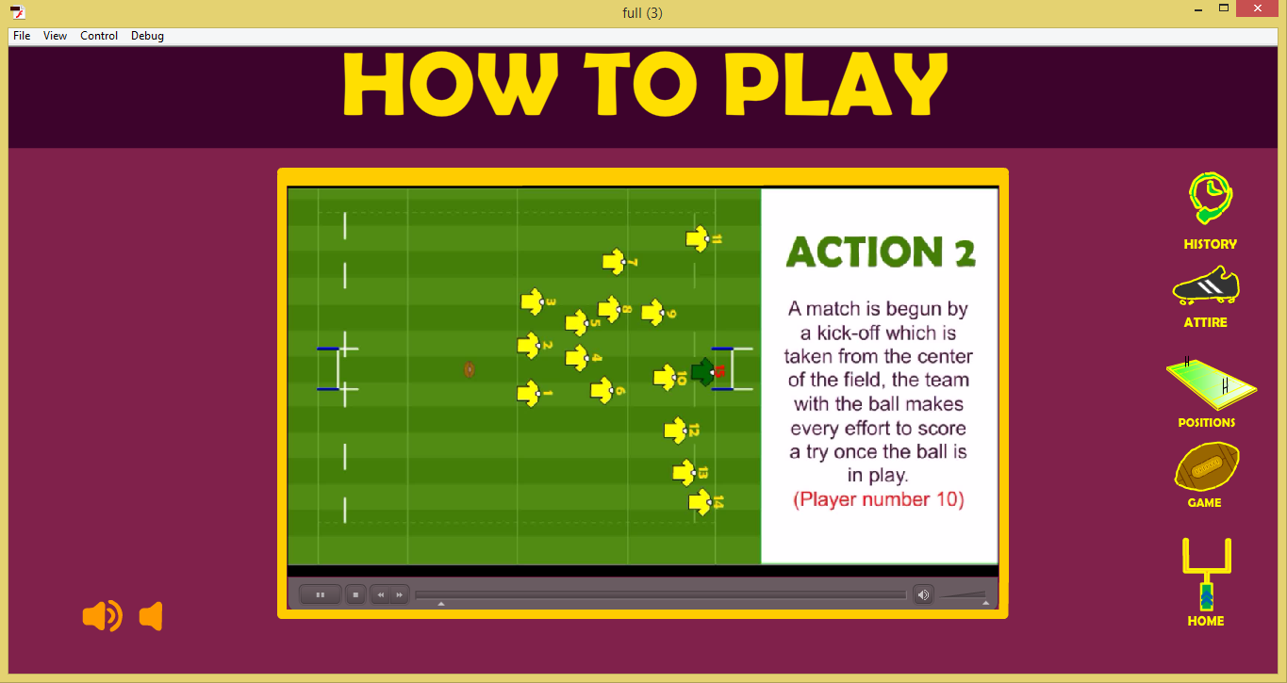
Scene 5

Slide 17
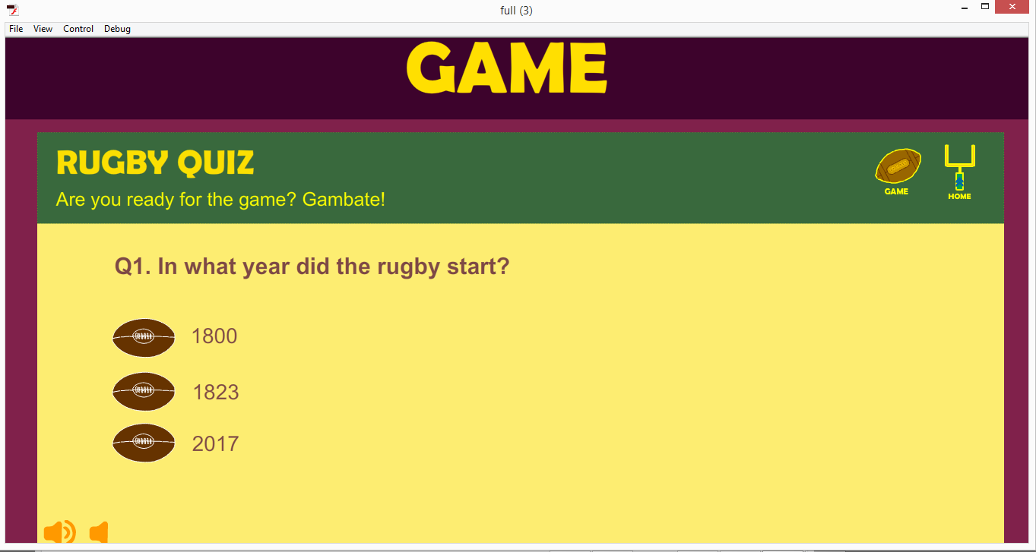
Scene 6

Slide 18
ADVANCED CODING

